Slide 1
Financial ANALYSIS OF CENSUS DATA
By BALA CHANDAR B.

Slide 2
contents
Introduction to Big Data
Big Data Use Cases
Big Data & Hadoop
Hadoop Framework
YARN Architecture
Project Outline
Tools Used
Project Summary
Conclusion

Slide 3
Big data
Big Profit
Big Information
Big Data
Big Wisdom
The 4 V’s of Big Data,
Volume
Variety
Velocity
Veracity

Slide 4
Big Data Use cases
Social network analysis
A 360-degree view of customer
Web app optimization
Fraud detection
Life sciences research
Weather forecasting
Healthcare outcomes
Advertising analysis
Location based tracking & services
Natural resource exploration
Predictive analysis
“Data is the oil of 21st century, and analytics is the combustion engine”

Slide 5
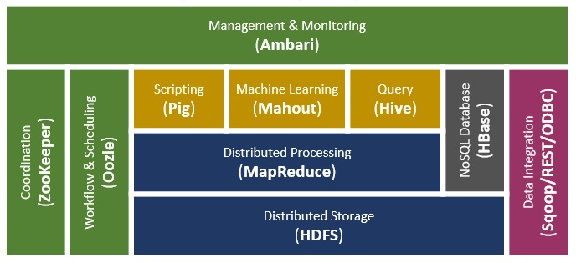
Hadoop framework

Slide 6
Project synopsis
Formatting and joining the datasets.
Annual Income calculation.
Number of Tax-Filer-Citizens based on their Tax-Filer-Status.
Income based on educational background.
Average or Per Capita Income based on the citizenship.
Average or Per Capita Income based on country of born.
Gnerating Income – Tax for each individual citizen by following US-Tax rates(2016).
Exporting data from HDFS to MySQL.

Slide 7
Formatting and joining the datasets Tool used: Apache Pig
Two raw census datasets has to be analyzed 'sample.dat' and 'agegroup.dat‘ which are in JSON format.
sample.dat file consists the details of citizens like Age, Education, Martial Status, Gender, Tax filer status, Annual Income, Parents, Citizenship, Country of Born & Weeks Worked.
agegroup.dat file contains age and respective age group details.
JsonLoader
Storing
“Apache Pig is a high-level platform for creating programs that run on Apache Hadoop.”

Slide 8
Annual income calculation Tool used: Apache Pig
Joined data is loaded into Pig Grunt Shell. The syntax is,
income = LOAD '/Project/Census/ProjectData/part-r-00000' USING PigStorage(',') AS(ID,Age,AgeGroup,Education,MartialStatus,Gender,TaxFilersStatus,Income:DOUBLE,Parents,CountryOfBirth,Citizenship,WeeksWorked);
Annual income is calculated as,
annual = FOREACH income GENERATE $0,$1,$2,$3,$4,$5,$6,ROUND_TO($7*12,2),$8,$9,$10,$11;
STORE
“Apache Pig is data-flow language”

Slide 9
Number of Tax-Filer-Citizens based on their Tax-Filer-Status. Tool Used: Apache pig
GROUP
FOREACH, GENERATE GROUP & COUNT
STORE, USING, PigStorage
“Apache Pig is an abstraction over Map-Reduce.”

Slide 10
Number of Tax-Filer-Citizens based on their Tax-Filer-Status. Tool Used: Apache pig
“The language used in Apache Pig is called as Pig Latin”

Slide 11
Income based on educational background Tool Used: Apache pig
GROUP
FOREACH, GENERATE GROUP, SUM
ORDER, BY
STORE, USING, PigStorage
”Apache Pig is a tool used to analyze large amounts of data by representing them as data flows.”

Slide 12
Income based on educational background Tool Used: apache PIG
SAMPLE OUPUT:
High school graduate 887049
Children 743548
Some college but no degree 544230
Bachelors degree(BA AB BS) 328712
10th grade 140397
7th and 8th grade 128254
11th grade 117724
“ Apache Pig is a high-level procedural language platform developed to simplify querying large data sets in Apache Hadoop and Map-Reduce.”

Slide 13
Average or Per Capita Income based on the citizenship Tool used: Apache Hive
hive> SELECT citizenship,ROUND(AVG(Income),2) AS AverageIncome FROM census GROUP BY citizenship ORDER BY AverageIncome DESC;
SAMPLE OUTPUT:
France 51161.16
Portugal 43908.36
Cambodia 37148.4
Japan 37023.36
Scotland 25408.56
Peru 24216.72
“Hive gives an SQL-like interface to query data stored in various databases and file systems that integrate with Hadoop.”

Slide 14
Average or Per Capita Income based on country of born. Tool Used: Apache hive
hive> SELECT nativeBorn,ROUND(AVG(Income),2) AS AverageIncome FROM census GROUP BY nativeBorn ORDER BY AverageIncome DESC;
“Hive provides the necessary SQL abstraction to integrate SQL-like Queries (HiveQL) into the underlying Java API.”

Slide 15
Generating Income – Tax for each individual citizen by following US-Tax rates(2016) Tool used: Apache Map-reduce
Writing Map-Reduce java program to find the tax rates for each citizens by following US-Tax rates.
SAMPLE OUTPUT:
1385,0,infants, Children, Never married, Female, Nonfiler,31908.72, Both parents present, United-States, Native- Born in the United States,0,0
1462,0,infants, Children, Never married, Female, Nonfiler,19277.52, Mother only present, United-States, Native- Born in the United States,0,0
1675,0,infants, Children, Never married, Male, Nonfiler,26351.88, Both parents present, United-States, Native- Born in the United States,0,0
“Apache Map-Reduce is a programming model and an associated implementation for processing and generating big data sets with a parallel, distributed algorithm on a cluster.”

Slide 16
Exporting data from HDFS to MySQL Tool used: Apache sqoop
Apache Sqoop
sqoop export --connect jdbc:mysql://localhost/project --username root --password 4858 --table census --export-dir /Project/Census/TaxWithPercentage/part-r-00000
“Apache Sqoop is a tool designed for efficiently transferring bulk data between Apache Hadoop and structured datastores such as relational databases.”

Slide 17
Analysis SUMMARY
From the given census data following analysis where done,
Proposing government to lay the tax those who are not paid.
Submitting detailed report of per capita income details to the government.
Created and stored structured processed data into MySQL database.

Slide 18
References
https://hadoop.apache.org/docs/r2.6.0/
https://www.ibm.com/big-data/us/en/
https://pig.apache.org/docs/r0.14.0/
https://cwiki.apache.org/confluence/display/Hive/Home
http://sqoop.apache.org/
https://www.irs.com/articles/2016-federal-tax-rates-personal-exemptions-and-standard-deductions
Hadoop: The Definitive Guide, 4th Edition - O'Reilly Media

Slide 19
Thank you

